Slide 1


THE STRUCTURE OF INSPECTION IN THE TURKISH EDUCATION SYSTEM
Harun GONCU
Education Inspector
April 2022

Slide 2
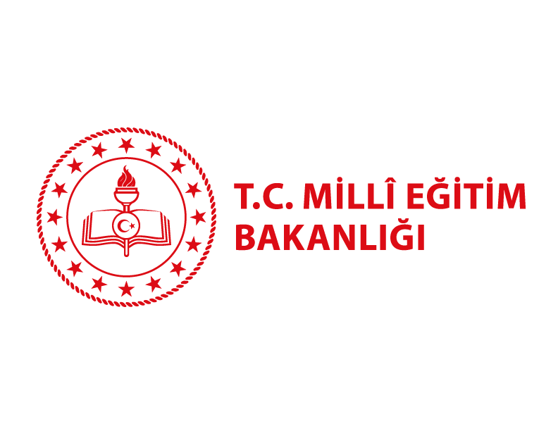

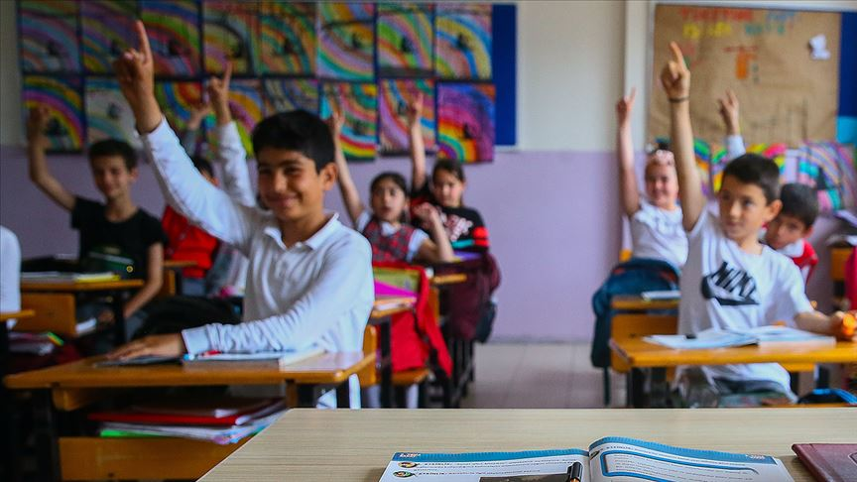
As the Presidency of the Inspection Board; “Through guidance and inspection; It is is our basic mission and priority to achieve excellence in education and ensure that every citizen receives quality education at international standards by leading individual and institutional development.
MoNE The Presidency of Inspection Board
April 2022

Slide 3
CONTENTS
MoNE The Presidency of Inspection Board
April 2022
Inspection in the Turkish Education System
Central Inspection (Inspection Board)
Local Inspection (Education Inspectorates)
Inspection Principles and Standards
Inspection of Schools and Other Educational Institutions
Monitoring the Post-Inspection Development Programs of Schools
Self-Evaluation Process Conducted in Schools and Institutions

Slide 4
1. Inspection in the Turkish Education System
MoNE The Presidency of Inspection Board
April 2022
In the Turkish education system, education and training are carried out under the inspection and control of the State, in line with Atatürk's principles and reforms, in accordance with modern science and education principles, according to Article 42 of the Constitution.
According to the National Education Fundamental Law, the Ministry of National Education has given the responsibility for the execution, inspection and control of the education service on behalf of the state.
The education inspection system in Turkey is carried out through two different inspection structures, "central inspection" and "local inspection", based on the country's administrative structure.
The supervision of all educational institutions at the national level (except for higher education institutions) is carried out from the center by the Inspection Board.
Educational inspection at the local level is carried out by the Education Inspectors Departments within the body of the National Education Directorates in 81 provinces.

Slide 5
2. Central Inspection
MoNE The Presidency of Inspection Board
April 2022
According to the Presidential Decree No. 1, The inspection, monitoring, evaluation, guidance activities, and examination and investigation practices of the education and training services are carried out by the Ministry of National Education on behalf of the state and The Board of Inspection is responsible for all of these practices.
The Presidency of Board of Inspection
The Board of Inspection is directly subordinate to the Minister and its duty center is in Ankara. The Board consists of the President and the heads of departments, and the chief inspector, inspector and assistant inspectors working in duty and coordinating centers.
In order to increase the effectiveness of the guidance and inspection services carried out by the Board of Inspection, Coordinating centers were established in the provinces of Istanbul and Izmir.

Slide 6
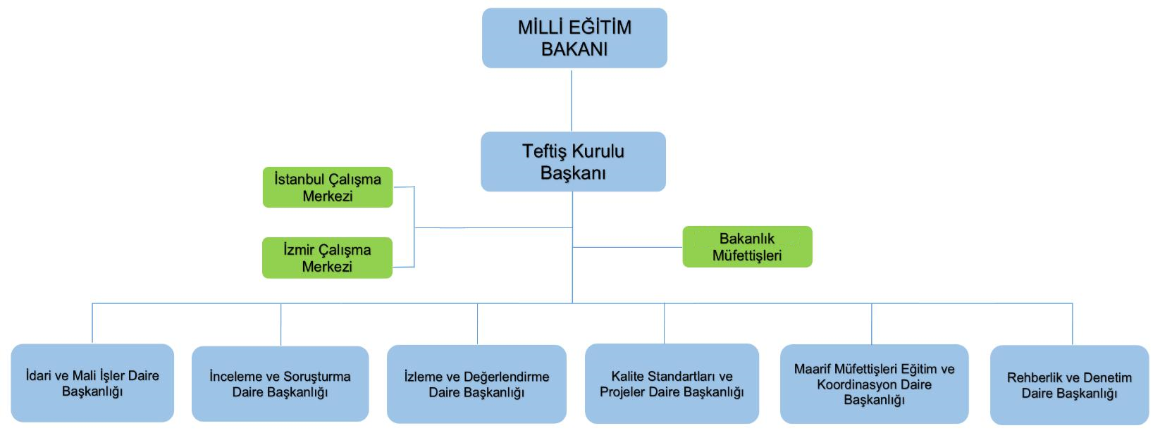
TheAdministrative Structure of the Presidency of Board of Inspection
MoNE The Presidency of Inspection Board
April 2022
The Board of Inspection, which directly subordinates to the Minister, serves with 6 departments under the President of the Inspection Board.
A total of 485 inspectors, including 445 Ministry Inspectors and 40 Ministry Head Inspectors, work in the Inspection Board.

Slide 7
The Duties of the Presidency of Board of Inspection
MoNE The Presidency of Inspection Board
April 2022
Main Duties of the Board of Inspectors Defined by Laws
On the order or approval of the Minister, it performs the following duties at the National level:
In the matters falling within the scope of the Ministry, to guide the Ministry personnel, Ministry schools and institutions, private education institutions and real and legal persons.
To carry out the control and inspection of the services provided by the Ministry or under the inspection of the Ministry in cooperation with the relevant units, to analyze, compare and measure the processes and results according to the legislation, predetermined goals and objectives, performance criteria and quality standards, evaluate based on the evidence, report the results obtained and forwarding it to the relevant units and persons,
To carry out inspection, examination and investigation works and transactions through Ministry Inspectors, within the framework of the duties and authorities of the Ministry, with an understanding that emphasizes the preventive, educational and guidance approach regarding the activities and transactions of the Ministry organization and personnel and all kinds of institutions under the inspection of the Ministry.

Slide 8
3. Local Inspection
MoNE The Presidency of Inspection Board
April 2022
According to the Regulation on Education Inspectors of the Ministry of National Education, Education Inspectorships were established in 81 provinces to carry out guidance, on-the-job training, inspection, evaluation, examination, research and investigation services of formal and non-formal education institutions of all degrees and types.
Education Inspectorates
Education Inspectorates, which work under the Provincial Director of National Education, as Department of Education Inspectors; It consists of the head of education inspectors, vice-presidents of education inspectors, education inspectors, assistant education inspectors and personnel working in the education inspectors presidency office.
A sufficient number of Education Inspectors are employed in each province, taking into account the number of students and teachers in the province. Currently, approximately 1350 education inspectors work in the provinces.

Slide 9
The Duties of Education Inspectorates
MoNE The Presidency of Inspection Board
April 2022
According to the Education Inspectors Regulation of the Ministry of National Education;
. To carry out guidance, on-the-job training, inspection, evaluation, examination, research and investigation services of formal and non-formal education institutions of all degrees and types in provincial national education directorates,
. To prepare the annual activity program with a three-year work plan,
. To examine, analyze and evaluate the guidance and inspection evaluation reports prepared by the guidance and inspection groups,
To prepare the annual guidance and inspection evaluation report containing the current situation, problems and solution suggestions, to inform the provincial national education directorate and to send a copy to the Presidency.
To carry out studies to increase the quality of education and private student accommodation services in the province, to prepare the necessary proposals and notify them to the provincial directorate of national education in order to ensure the development of institutions and their operation in accordance with the legislation, plan and program.
To monitor and evaluate the development of institutions.

Slide 10
4. The Guidance Inspection Principles and Standards
MoNE The Presidency of Inspection Board
April 2022
Guidance and Inspection Principles
Inspection principles and bases have been determined in the guidance and inspection guides prepared by the Presidency of Board of Inspection..
The following principles are observed in guidance and inspection:
Individual and institutional differences and environmental factors should be taken into account.
b) It should be based on correction, improvement and development by emphasizing leading and preventive guidance.
c) It should disseminate examples of good practice.
d) It should ensure the risk areas of the system to be identified and eliminated.
e) It should prevent irregularities and corruption.
f) It should be clear, transparent, equal, democratic, holistic, reliable and impartial..
g) It should be based on cooperation and participation.
h) It should highlight, encourage and reward success.
i) It should be based on scientific and objective principles..
j) It must be effective, economical and fertile.

Slide 11
MoNE The Presidency of Inspection Board
April 2022
Mission Standards
To ensure that the duties of the inspectors are fulfilled in an efficient and effective manner in accordance with the purpose, and that the results of their duties are fair, legal and reliable,
For determining the general principles and rules which ministry inspectors must obey and ensure unity of practise in the execution of their duties, mission standards have been established.
While performing their duties, inspectors are obliged to comply with these standards
Quality Framework
School Institution Inspection Guides

Slide 12
MoNE The Presidency of Inspection Board
April 2022
Quality Framework
In 2014, by the Ministry of National Education;
To clarify the general objectives of the education and training system and to increase the quality,
To determine the quality standard and criteria of the education and training system,
To make the education and training system achieve to international standards,
To increase accountability by making the education and training system transparent,
For this purpose, National Education Quality Framework was established
We continue to work on the implementation of the National Education Quality Framework in education inspection.

Slide 13
MoNE The Presidency of Inspection Board
April 2022
School Institution Inspection Guides
For determining the principles to be applied in the inspection of public and private schools and institutions affiliated to the Ministry of National Education, inspection guides specific to school/institution types have been prepared by the Board of Inspection.
Inspection guides are taken as a basis in the inspections carried out by both the Board of Inspection and also the Education Inspectorates.
In general Inspection Guidelines include;
. A. PURPOSE, SCOPE, BASIS AND DEFINITIONS
B. GUIDANCE AND INSPECTION PRINCIPLES
C. GUIDANCE AND INSPECTION BASES
I. PLANNING AND EXECUTING THE GUIDANCE AND INSPECTION PROCESS
II. GUIDANCE AND INSPECTION REPORTING STANDARDS
III. MONITORING AND EVALUATION

Slide 14
5. Inspection of Schools and Other Educational Institutions
MoNE The Presidency of Inspection Board
April 2022
The inspection of schools and institutions is carried out by an inspector group of 3 people, according to predetermined plans, taking into account the Principles of Inspection, the duty standards of Ministry Inspectors and Inspection Guides.
The inspections of the units of provincial national education directorates and district national education directorates are completed in 3 working days on average, inspections of schools and other institutions other than schools are completed in 1-2 working days depending on the characteristics of the institutions.
Coordination
In case the inspection works are carried out in groups, the person appointed by the Presidency among the inspectors in that group becomes the working group responsible. Group leader represents the group, ensures that the examination and inspection process carried out by the group to be carried out on time and in a suitable good manner.
Inspection Preparation, Accumulating Intelligence/Preliminary Research
Inspectors conduct a preliminary research by collecting the information they may need before the guidance and inspection they will carry out.

Slide 15
5. The Inspection of Schools and Other Educational Institutions
MoNE The Presidency of Inspection Board
April 2022
Inspection Introductory Meeting
At the beginning of the inspection process, the working group leader holds a meeting with the inspectors in the inspection group at the place of duty.
In addition, each inspection group holds a meeting with the school/institution principals and staff before starting the inspection. It is important to establish clear, constructive communication and cooperation between the inspectors and the supervisee in terms of improving education and training.
Utilizing Inspection Guides
Inspection guides prepared separately for each type of institution/school by the Presidency are used during the inspection process. For matters not included in the inspection guide, guidance and inspection are carried out in accordance with the provisions of the relevant legislation. References to legislation in the guide are only for informational purposes.

Slide 16
5. The Inspection of Schools and Other Educational Institutions
MoNE The Presidency of Inspection Board
April 2022
Being leading and guiding of inspection
Inspectors guide to those who are related authority for solving problems and improving the quality of services, criticism and interpretation cannot be made without obtaining their information.
The Evaluation of Previous Reports
It is examined whether the matters identified and criticized in the previous inspection reports and communiqués texted in the previous inspections have been corrected or not and whether the recommendations have been fulfilled or not.The implementation status of the activities included in the prepared development plans and the status of reaching the targets are examined based on the data, and the reasons for the unimplemented activities are questioned. Improvement plans are updated when it is necessary.

Slide 17
5. The Inspection of Schools and Other Educational Institutions
MoNE The Presidency of Inspection Board
April 2022
Obtaining Findings and Developing Recommendations
Examinations are made regarding the current situation, work, process and practices of the inspected school/institution in the main inspection areas determined in the inspection guides; The necessary information is obtained from the relevant persons and the documents are checked.
In general, in the inspections carried out in Schools and Institutions controls of checking are done on the schools‘;
Educational environments
Educational activities
Management activities
Financial process and transactions
Applications carried out within the scope of Covid 19 measures
Monitoring and evaluation activities
The necessary information is obtained from the relevant persons and the documents are checked. In inspection and controls, the works and transactions found to be deficient/wrong and the issues that need to be improved are determined and the findings and suggestions regarding these matters are redacted in the report.

Slide 18
5. The Inspection of Schools and Other Educational Institutions
MoNE The Presidency of Inspection Board
April 2022
Self-evaluation findings made by institutions are also taken into account in guidance and inspection activities.
The Closing Meeting of Inspection Evaluation
In this meeting, the matters such as the findings about the school/institution, the importance and level of these identified issues, their strengths and weaknesses, how the development plan will be prepared and shared are handled and the opinions and suggestions of the administrative authority and also of teachers and other personnel opinions and suggestions are heard by taking notes.

Slide 19
5. The Inspection of Schools and Other Educational Institutions
MoNE The Presidency of Inspection Board
April 2022
The Preparation and Submission of Guidance and Inspection Report
The guidance and inspection report is prepared in sufficient copy (provincial, district and school/institution) and submitted to the Board of Inspection, together with its annexes, if any, within the following week after the completion of the inspection.
The Sharing of The Findings with the Inspected Institution
Guidance and inspection reports written as a result of the inspections performed by the inspectors are dispatched to the relevant school/institution after the control check by the Presidency of Inspection Board. A progress report is prepared by the relevant school/institution in line with the problems and solution suggestions included in the report.

Slide 20
6. Post-Inspection Monitoring and Evaluation Activities
MoNE The Presidency of Inspection Board
April 2022
According to the issues identified and suggestions made during the inspections of schools/institutions and provincial/district national education directorates, a improvement plan including amendment/development activities is prepared in accordance with the principles and form determined by the Presidency of Inspection Board.
The implementation process of the development plan is monitored and evaluated annually by the provincial/district directorates of national education and, if necessary, by the higher units
Apart from the monitoring and evaluation based on the issues identified in the inspections and the suggestions made, according to certain indicators the level of school/institution's achievement of its goals and its objectives in line with the inspection standards determined by the Presidency of Inspection Board and within the national education quality framework is monitored and evaluated by the provincial/district directorate of national education every year.

Slide 21
7. Self-Evaluation Process Performed in Schools and Institutions
MoNE The Presidency of Inspection Board
April 2022
Teachers' board meetings held in schools can be considered as self-evaluation activities for schools.
The self-evaluation process of schools and institutions in Turkey started to be implemented primarily in vocational education institutions within the scope of Vocational and Technical Education Quality Assurance System in 2019.
Finally; The Education Inspectors Regulation of the Ministry of National Education, put into effect on March 1, 2022, obliges all educational institutions to conduct self-evaluation every year and to send a copy of the self-evaluation report to the department of education inspectorate.
During the self-evaluation process, necessary guidance is given to the institutions by the education inspectorates.In the inspections, it is essential to evaluate the implementation status of the development plans prepared according to the suggestions made as a result of the self-assessments performed by the institutions and the suggestions made as a result of the previous inspections, the achievement of the students' achievements in the curriculum, the evaluation of the institutional developments.

Slide 22
8. General Evaluations
MoNE The Presidency of Inspection Board
April 2022
Yapılan araştırmalar, okullarda kısa süre içinde yapılan dış değerlendirmelerin, eğitim kalitesini geliştirmede tek başına yeterli olmadığını (Bozkuş, K. & Gündüz, 2013) okullarda kalite gelişiminde sürekliliği sağlayacak dinamik mekanizmalara ihtiyaç duyulduğunu göstermektedir.
Simons (2013) okulların kalitesini geliştirmek için en iyi yollardan birisinin okul öz değerlendirme olduğunu belirtmektedir. Türk Eğitim Denetim sisteminde yapılan son değişikliklerle öz değerlendirme tüm okul/kurumlar için zorunlu hale getirilmiştir.
Ancak okullardaki örgütsel körlüğün önüne geçilmesi için (Vanhoof, Petegem, 2007) öz değerlendirme süreci dış değerlendirme ile desteklenmelidir (Kurum G, 2019).
Okul gelişiminin farklı model ve yöntemlerle desteklenmesine yönelik arayışlarımız devam etmektedir.
Okul ağları, okullarda gelişimin sağlanması ve eğitim kalitesinin iyileştirilmesi açısından önemli bir araç olacaktır.
The studies show that external evaluations made in a short time at schools are not sufficient on their own to improve the quality of education (Bozkuş, K. & Gündüz, 2013), and that dynamic mechanisms are needed to ensure continuity in quality improvement in schools.
Simons (2013) states that one of the best ways to improve the quality of schools is school self-evaluation. With the latest changes made in the Turkish Education Inspection System, self-evaluation has become compulsory for all schools/institutions.
But, in order to prevent organizational blindness in schools (Vanhoef, Petegem, 2007), the self-evaluation process should be supported by external evaluation (Kurum G, 2019).).
Our search for supporting school development with different models and methods continues.
School networks will be an important tool in terms of ensuring development in schools and improving the quality of education.

Slide 23
MoNE The Presidency of Inspection Board
April 2022
THANK YOU
Web: http://tkb.meb.gov.tr/
E-mail: harun.goncu@meb.gov.tr

