Slide 1
Project Polycentric inspections of networks of schools Erasmus+ 2014 Key Action 2 (KA2), Strategic Partnerships Project Ref. number: 2014-1-UK01-KA200-001798 Проект „Полицентрично инспектиране на мрежи от училища“

Slide 2
Policentric Inspection of School Networks Project
Duration: 09.2014 - 08.2017
Project partners:
Great Britain – Institute of Education at the University of London, OFSTED
Bulgaria – Sofia University ‘St. Kliment Ohridski’, RDE – Sofia-city, 10 schools in the city of Sofia
Ireland – University of Dublin
North Ireland – Inspectorate of Education, network of schools and other organisations from Belfast
Holland – University of Tuente, the City Inspectorate and a network of schools

Slide 3
Polycentric Inspection of School Networks Project
Objectives and expected benefits of polycentric inspection
To test a model of polycentric inspection, different from the normatively regulated centralized model of inspection, with an inspection framework prepared and different sources of information used, based on self-assessment and mutual evaluation of schools in the network, to improve the quality of education.

Slide 4
Inspection technology
I. Pre - inspection activities.
1. Preparation of an order for approbation of a model of polycentric inspection of a network of 10 metropolitan schools.
2. Conducting a working meeting with senior experts from RDE - Sofia-city to get acquainted with the objectives of the inspection, materials on the topic and the choice of content format - inspection plan or preparation of an inspection framework.
3. Conducting a working meeting with senior experts from RDE - Sofia-city to prepare a framework for polycentric inspection of a network of 10 metropolitan schools on "Interaction of the school with parents."
4. Approval by the head of RDE - Sofia-city of inspection documentation - inspection technology, inspection framework, statement of results, report on the results of the inspection for each school, report on the results of the inspection and its effectiveness in relation to the school network and of RDE - Sofia-city.
5. Conducting a working meeting of senior experts from RDE - Sofia-city with the project manager.
6. Participation of the team from RDE - Sofia-city in a working meeting with the schools from the network to present the framework for inspection.

Slide 5
Inspection technology
II. Inspection.
1. Presentation to the inspectors from the schools with a self-assessment report / with supplemented after the self-assessment measures for improving the work with the parents / and a report for mutual evaluation (with updated on the basis of the recommendations of the mutual evaluation measures for improving the work with the parents).
2. Preparation of a schedule and inspection in the schools of the network / order of the head of the RDE to appoint a commission of 5 senior experts for inspection of 2 schools in the period 11-22.04.2016 /.
3. Monitoring of the inspection process by the head of the department "Organizational-methodical activity and control" and by the project manager.
4. Preparation by the inspecting senior experts of a statement of results and a report on the results of the inspection for each school in the network with recommendations and the need for support from the network.
5. Preparation of an analysis report on the results of the inspection
and its effectiveness with regard to the school network and the RDE.
III. Organizing and conducting a working meeting of the inspection team with the principals of the schools from the network to get acquainted with the results of the inspection and propose measures to improve the work with parents.

Slide 6
Framework for inspection of a network of 10 metropolitan schools on the topic "Interaction of the school with parents"
Subject of evaluation: the quality of work with parents at school.
Standards, indicators /from 4 to 6/ and norms /determine for each standard the minimum indicators for the implementation of the standard, the degree of implementation of the standard and the degree of quality of work with parents at school/.
Methods of verification: verification of compulsory school and other types of documentation; conversations with principal, deputy principals, teachers, psychologists, pedagogical advisors, students, parents.
Sources of information /for all standards and indicators to them are used as universal sources/:
1. Report-analysis for self-assessment of schools for work with parents.
2. Report from the conducted mutual evaluation between the schools in the network for the work of the schools with the parents.
3. Interviews with the principal, deputy principals, pedagogical advisor /psychologis /, parents of students, school board, students.
Period of inspection: 16.09.2014 - 25.03.2016 /according to the prepared framework/; inspection carried out: 10.03. 2016 – 27.04.2016.
/due to extended period of self-assessment and mutual evaluation /.

Slide 7
STANDARDS
1. Involvement of parents in school life through a system of school partnership.
2. Application of various forms of communication with the parents for their inclusion in all planned activities of the school, in order to achieve the goals of the education.
3. Encouraging the initiative of parents in interaction with the school, to develop the interests and abilities of students.
4. Improving the professional competence of the pedagogical staff for effective partnership with the parents.
.

Slide 8
Standards - levels of performance /levels of quality of school interaction with parents
Unsatisfactory performance - the minimum indicators have not been accomplished.
Good performance - only the minimum indicators are accomplished.
Very good performance - more than the minimum indicators have been accomplished.
Excellent performance - all indicators to the standard are accomplished.
Low quality - standards 2 and 3 are not accomplished.
Good quality - standards 2 and 3 are accomplished.
Very good quality - more than standards 2 and 3 are accomplished.
High quality - all standards are accomplished.

Slide 9
Degree of compliance between the school's self-assessment, the assessment from the mutual assessment and the assessment from the inspection regarding the quality of the interaction with the parents /criteria/
Relation of the first, second and third standards of the Inspection Framework to the first, second, third and fourth standards of the Framework for self - assessment and mutual evaluation.
Covering the expressed opinions of the three groups of sources of information - students, teachers and parents, in the conversations with them.
A mechanism for interaction between the communities in the school and the parents as partners has been developed.

Slide 10
Recommendations for the school network
1. Conducting working meetings of school boards / independent voluntary associations to support the activities of educational institutions / and student councils and parliaments / student self-government bodies / to share lessons learned, good practices and support newcomers.
2. Exchange of good practices and support in connection with the conducted qualification forms for partnership of the school with the parents, for improvement of the professional competence of the pedagogical and non-pedagogical staff.

Slide 11
Recommendations for the school network
3. Exchange of good practices and support on healthy eating of students and development of their motor culture.
4. Exchange of good practices and support regarding project work and interaction with parents.
5. Creating a website of the school network for interaction and support after the end of the project time frame.

Slide 12
Polycentric Inspection of School Networks Project
Achieved results - for the school network
The network operates on an equal footing with its participants, with a responsible attitude to perform the tasks according to the set goals.
The schools take measures to improve their activities, and throughout the period they function as a network in a continuous process of interaction and support.
Within the project, although existing as an informal school network, it could continue to exist in search of sustainability of results on the chosen topic.

Slide 13
Polycentric Inspection of School Networks Project
Achieved results – for Regional Department of Education – Sofia-cit
Adaptation of the regulations and the procedures applied during the inspection to the polycentric inspection, with examination of the results for the network and for the RDE.
Introduction to the education system and inspection models in the Republic of Ireland and Northern Ireland - through the acquisition of good practices.
Improving the professional competence of the team of RDE - Sofia-city, participating in the project.

Slide 14
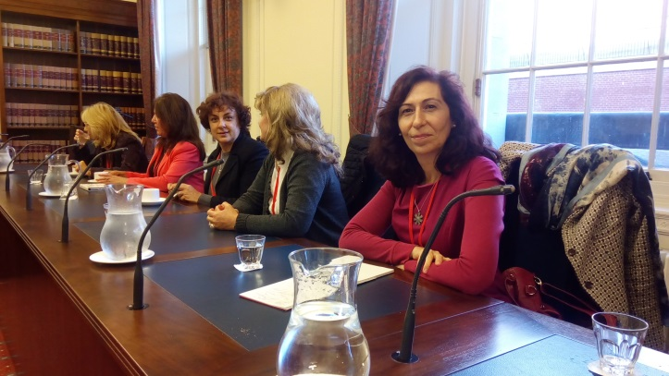
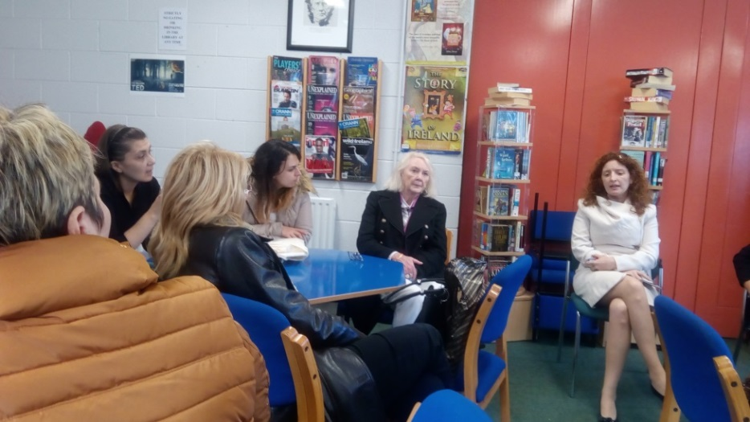
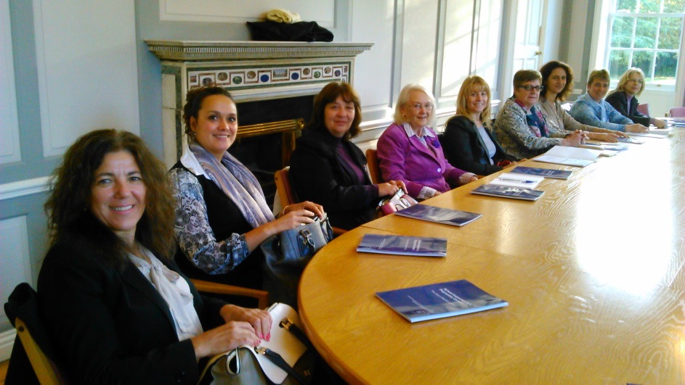
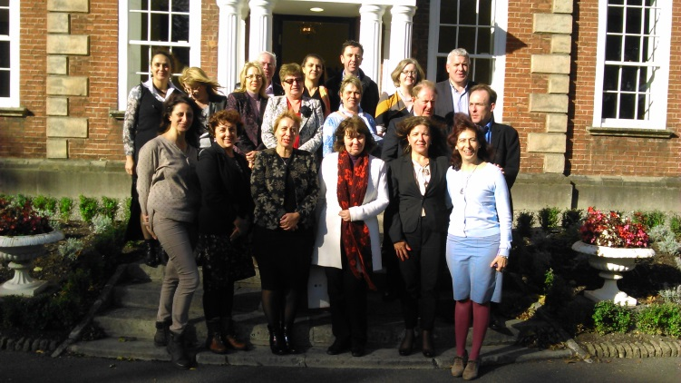
Dublin – introduction to the European Inspection Models

Slide 15
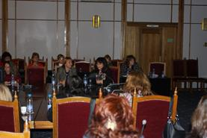
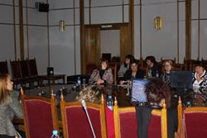
Successful Partnerships of RDE – Sofia - city Еrasmus+ Projects

Slide 16
REGIONAL DEPARTMENT OF EDUCATION TEAM – SOFIA-CITY

