Slide 1
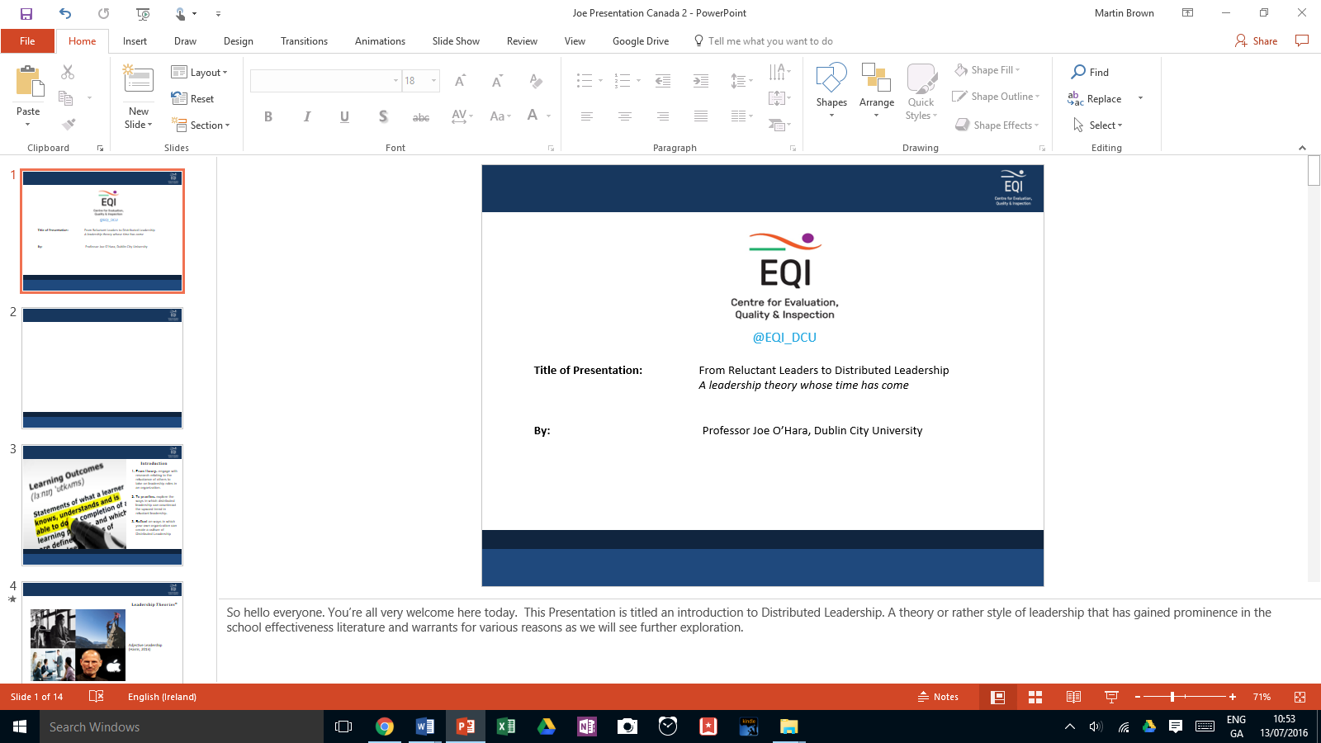

Title of Paper: The challenges and opportunities Polycentric Evaluation in Ireland (And Elsewhere)
Date: 05-04-2022
Time: 9.30 -10.00

Slide 2
$$\text{O}\text{utline} \text{of} \text{Presentation}$$
The request
Provide an Overview on the Challenges and Opportunities for Polycentric Inspection / Professional Learning Networks in Ireland
Present research findings from the Island of Ireland
A suggestion (But please ignore)
Conceptualising Polycentric Inspection across Domains

Slide 3
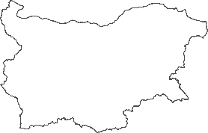
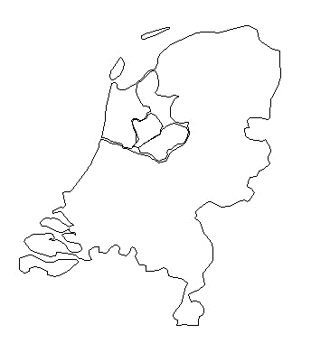

$$\text{R}\text{ecap} \text{on} \text{Stages} \text{involved} \text{in} \text{the} \text{research} \text{for} \text{Polycentric} \text{I}$$
STAGE 1
Mapping (DCU, IOE, University of Twente, University of Sofia, and education partners – Inspectorates of Education and Networked schools) 4 existing examples of Educational networked school evaluation systems
STAGE 2
Literature review and ex ante evaluation
STAGE 3
Scoping good examples across Europe (survey and document analysis of SICI profiles)
STAGE 4
Studying impact of 4 examples of Educational network inspections. Dissemination: narratives, interactive map on website, MOOC

Slide 4
$$\text{B}\text{ackground} \text{Information} \text{on} \text{elements} \text{of} \text{Polycentric} \text{Inspection} \text{in} \text{Northern} \text{Ireland}$$
High Self Evaluation Capacity
Medium to High Accountability Structures
Significant Value placed on School Self Evaluation and Inspection
Area Based Evaluation
In reality - Now non Existent
(A complicated story: Politics, Value for Money, etc)
Elements of Polycentric Inspection remain ( District Inspection, localised Data, etc)

Slide 5
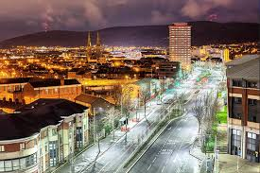
$$\text{B}\text{ackground} \text{Information} \text{on} \text{West} \text{Belfast}$$
One of the highest levels of people claiming unemployment benefit in Northern Ireland (NI)
The highest proportion of people (76%) living in the most deprived Super Output Areas of NI
Ranks first on the NI Multiple Deprivation Measure
A significant number of the student population are entitled to Free school meals. 35% at Post-primary level and 60% at primary level.

Slide 6
Introduction
Questions from Polycentric I
Who should be involved in developing evaluation methodologies to ascertain the quality of Network activities?
Who should be involved in setting standards of Network activities?
Who should inspect the quality of Network activities?
(From Melanie Ehren)
Notes:
while one of the key objectives of the network was to enable students from one school to take a course or courses in another we found few incidences where this had actually taken place. Such a level of co-operation, implying, for example, joint timetabling was well beyond what was deemed feasible or indeed desirable. The following three tables and comments illustrate this point.

Slide 7
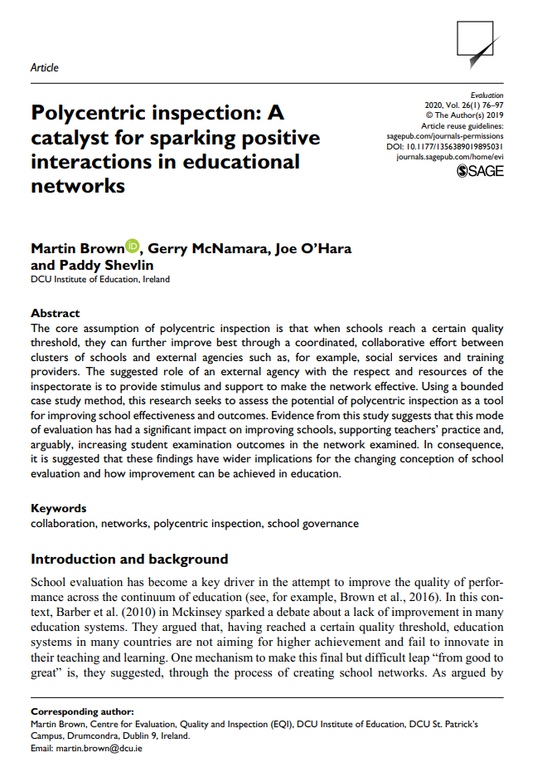
$$\text{S}\text{ummary} \text{of} \text{Findings} \text{from} \text{West} \text{Belfast}\text{ - }\text{Polycentric} \text{I}$$
In the context of wider debates about the role and function of inspection it is noteworthy that the role accorded to the inspectorate in this case was one of support and development rather than accountability.
Improvement Focussed
While there was strong support for collaborative learning and joint work on teacher professional development there was also evidence of potential limitations in co-operation and A DEGREE OF SURVIVING COMPETITIVENESS.

Slide 8
$$\text{S}\text{ummary} \text{of} \text{Findings} \text{from} \text{West} \text{Belfast}\text{ - }\text{Polycentric} \text{I}$$
While this network had a statutory basis and received public money, involvement of schools and other organisations was voluntary which certainly limits the accountability aspect of inspection of the network.
The emphasis which the Inspectorate itself placed on self-evaluation in the schools of the network as being the basis on which inspection of the network rests.
Strong Social Cohesion, Social Regulation (Hood)

Slide 9

$$\text{S}\text{ummary} \text{of} \text{Findings} \text{from} \text{Ireland}\text{ - }\text{Polycentric} \text{I}$$
Lessons Learned from Polycentric I
How might Polycentric I findings from Northern Ireland Compare with Ireland?

Slide 10

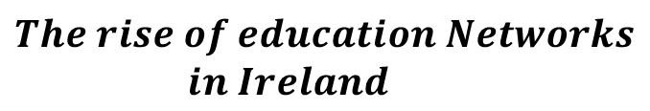
$$The rise of education Networks$$
$$in Ireland$$
We will incentivise voluntary school participation in new “Local Education Clusters” that encourage schools to
improve student outcomes by sharing best practice and school improvement experiences,
foster collaborative in and out-of-hours initiatives, staff peer mentoring and leadership,
and that allow for cost reductions through economies of scale
(Government of Ireland, 2016)
Notes:
READ

Slide 11
Introduction
Unanswered Questions from Polycentric I
Although the priorities of Local Education Networks are many.
There are however, issues that remain
As with any form of incentivised support governments will always require VALUE FOR MONEY

Slide 12
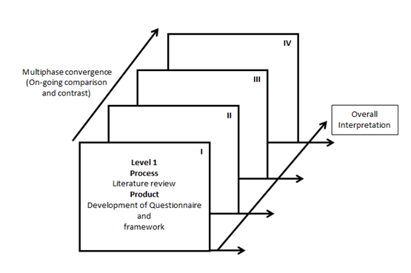

Phases of the research
$$Phases of the research$$
Phase 1: Mapping out Educational Networks in Ireland
Phase 2: Semi Structured Interviews
  48 (Principals, Teachers) in urban and rural primary/post-primary schools in Ireland
Phase 3: Survey
  320 Principals and teachers in urban and rural primary/post-primary schools in Ireland
Phase 4: Convergent Phase
Notes:
Thematic Analysis: Interview schedule and Framework
Prin urban Sec Prin urban C Prin urban VEC Teach urban Sec Teach urban C Teach urban VEC Prin rural Sec Prin rural C Prin rural VEC Teach rural Sec Teach rural C Teach rural VEC Prin Urban Teacher Urban Teacher Rual Teacher Urban

Slide 13


Findings
$$Priorities of the Network$$
Priorities such as Evaluation and Planning, Curriculum Development, Peer Learning and Support are concerned, for the most part as being either high priority or essential priorities of the network (Tables 1, 2, 3 and 6).

Slide 14
Findings
$$Priorities of the Network:Evaluation and Planning$$
High priority or essential priorities of the network
 | Not a priority | Low priority | Medium priority | High priority | Essential
To jointly evaluate an aspect of educational provision (e.g. literacy) in the area. | 8% | 10% | 25% | 37% | 20%
To jointly develop an improvement plan for an aspect of educational provision (e.g. literacy) in the area. | 11% | 5% | 25% | 40% | 19%
Table 1: Priorities of the Local Education Cluster: Evaluation and Planning

Slide 15
Findings
$$Priorities of the Network:Curriculum Development and CPD$$
High priority or essential priorities of the network
 | Not a priority | Low priority | Medium priority | High priority | Essential
To jointly develop and offer curricula | 14% | 12% | 16% | 40% | 18%
To jointly develop and provide continuous professional development for staff (e.g. teachers) | 4% | 4% | 14% | 35% | 43%
Table 2: Priorities of the Local Education Cluster – Curriculum Development and CPD

Slide 16

Findings
$$Priorities of the Network$$
High priority or essential priorities of the network
Collectively by being part of a Local Education Cluster we can also share CPD initiatives. For example, enhancing middle management was something we want to improve in our school.
Our Literacy, numeracy, SEN coordinators could benefit from this Cluster. Did you do this, what does it look like. I think that there’s so much excellent practice around us that we don’t need to send teachers half way around the country to get CPD. With this type of area CPD, it’s something my staff could relate to.
The biggest and most positive development from my perspective would be the creation of stronger links between primary and post primary schools which I think with the best will in the world is lacking in [Name of area].

Slide 17

Findings
$$Priorities of the Network:Peer Learning$$
Medium to low priorities of the network
 | Not a priority | Low priority | Medium priority | High priority | Essential
To ensure that strong education organisations support weak education organisations in improving | 11% | 19% | 38% | 26% | 7%
To develop joint assessments | 12% | 15% | 38% | 22% | 13%
Table 3: Priorities of the Local Education Cluster - Peer Learning and Assessment

Slide 18
Findings
$$Priorities of the Network:Infrastructural and human Resources$$
Medium to low priorities of the network
 | Not a priority | Low priority | Medium priority | High priority | Essential
To share resources: IT | 7% | 25% | 32% | 23% | 13%
To share school buildings and school grounds | 31% | 34% | 30% | 4% | 1%
To share staff | 20% | 19% | 35% | 21% | 5%
To share community workers and support services (e.g. school psychologist) | 6% | 10% | 19% | 38% | 27%
Table 4: Priorities of the Local Education Cluster : Infrastructural and human Resources
Notes:
Such a level of co-operation, implying, for example, joint timetabling was well beyond what was deemed feasible or indeed desirable. The following three tables and comments illustrate this point.

Slide 19
Findings
$$Priorities of the Network:Evaluation and Planning$$
Medium to low priorities of the network
It is relatively easy to start initiatives such as this, but when the workload takes over it is hard to keep initiatives like this one current. I see a huge amount of administration in maintaining a cluster, and with the extinction of middle management in schools I cannot see how it could be done.
The competitive nature of local schools will definitely impact on Local Education Clusters as there can often be distrust, especially when schools are competing to attract numbers. Finding time in an already congested and hectic schedule might mean that Principals and Deputies may not attend as more pressing matters may need to be dealt with in the school.
Sharing of Staff, joint CPD initiatives: A great idea if you’ve never been involved in time tabling. Real World. There is a lot more to Local Education Clusters than you think.

Slide 20

Conclusion
$$Summary$$
The benefits of Local Education Clusters were perceived as many.
There was widespread agreement that a key role of the network was to work together to provide joint planning and learning activities.
However, there may be considerable constraints on the level of co-operation possible, certainly in a voluntary network.

Slide 21


Conclusion
$$Mapping out Elements of Polycentric Inspection in Two Systems$$
Northern Ireland
Ireland

Slide 22

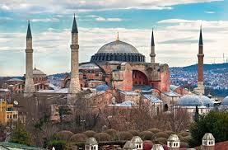

Conclusion
$$Mapping out Elements of Polycentric Inspection in Four Systems$$
What we already know
What elements of Polycentric Evaluation are required for effective Implementation across Education Systems?
Do we need yet another Evaluation Framework?

Slide 23
Conclusion
$$Mapping out Elements of Polycentric Inspection in Four Systems$$
Northern Ireland
Ireland
Turkey
Bulgaria
Portugal

Slide 24
Conclusion
$$Mapping out Elements of Polycentric Inspection in Four Systems$$
In all of these Cases
Issues concerning cohesion and regulation abound that have a profound effect on the value of and implementation of Polycentric Inspection
Issues concerning Network Governance abound
Moving forward, what then of Polycentric Inspection?

Slide 25
$$A suggested Exercise$$
High Social Cohesion
Low Social Cohesion
Hierarchist
Fatalist
Egalitarian
Individualist
The fatalist way (top right quadrant): characterized by rule-bound approaches to organization but there is little cooperation to achieve outcomes.
High Social Regulation
Low Social Regulation
Adapted from Hood (1998)

Slide 26
$$A suggested Exercise$$
The hierarchist way (top left quadrant): displays social cohesion and cooperation in order to meet rule-bound approaches to organization. Often characterized by bureaucracy.
High Social Cohesion
Low Social Cohesion
Hierarchist
Fatalist
Egalitarian
Individualist
High Social Regulation
Low Social Regulation
Adapted from Hood (1998)

Slide 27
$$A suggested Exercise$$
The individualist way (bottom right quadrant): atomized approaches to organization and which involve negotiation and bargaining between actors.
High Social Cohesion
Low Social Cohesion
Hierarchist
Fatalist
Egalitarian
Individualist
High Social Regulation
Low Social Regulation
Adapted from Hood (1998)

Slide 28
The egalitarian way (bottom left quadrant): high participation structures, in which all decisions are ‘up for grabs’ combined with an egalitarian culture and peer to peer support.
High Social Cohesion
Low Social Cohesion
Hierarchist
Fatalist
Egalitarian
Individualist
High Social Regulation
Low Social Regulation
Adapted from Hood (1998)

Slide 29
Conclusion
$$Questions and Answers$$
Notes:
while one of the key objectives of the network was to enable students from one school to take a course or courses in another we found few incidences where this had actually taken place. Such a level of co-operation, implying, for example, joint timetabling was well beyond what was deemed feasible or indeed desirable. The following three tables and comments illustrate this point.

Slide 30
Hierarchist - Ireland

