Slide 1
Networks for inclusive education
Melanie Ehren
m.c.m.ehren@vu.nl

Slide 2
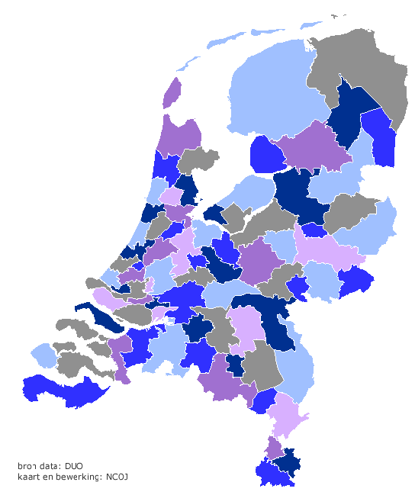
August 2014: Inclusive Education Act
76 regional partnerships in primary education
74 regional partnerships in secondary education
Notes:
Another example of network governance is from the Netherlands where the Department of Education issued the ‘Inclusive Education Act’ in 2014, requiring mainstream schools and schools for children with special needs to collaborate in regional partnerships with the purpose of ensuring ‘inclusive education’.
National government formed these partnerships, based on existing collaboration and geographical proximity.

Slide 3
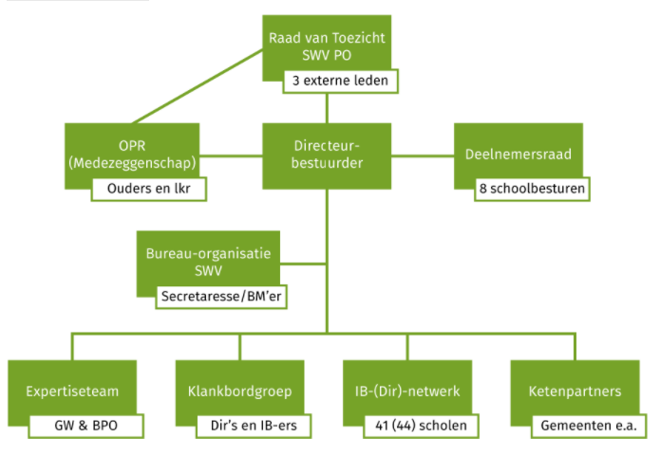
Notes:
SWV PO Brabantse Wal

Slide 4
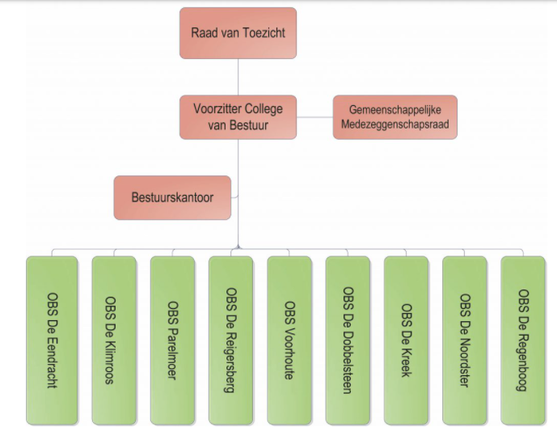
Notes:
Stichting SOM; one of the school boards of the SWV

Slide 5
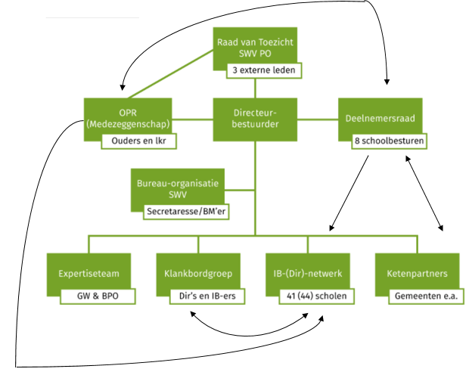

Slide 6
Dilemma’s
Multiple, overlapping structures which create confusion and conflicting interests
School board to school relations
School network (SWV) to school relations (direct or via school board)
Decision-making, financing, inspection and internal accountability

